Slide 1

Welcome
Speech Orientation
Notes:
Welcome to Stoa Speech Judge Orientation. Our goals today are to introduce ourselves and to better equip you as a Stoa Speech Judge.

Slide 2

Logos Forensics Association…
We believe that every student should have the opportunity to learn logic and rhetoric, to learn to defend their beliefs, and to develop the ability to communicate clearly and persuasively. We believe that this activity is the most important in developing these vital skills as well as training our students to be the leaders and representatives of Christ in future generations.

Slide 3
Judges…
You can do this!
Be responsive! You are the audience
Set aside personal bias and expertise
No discussion with speakers
No consultation with one another
Notes:
The greatest objection we hear from our judges is that they feel unqualified. Our response:
Ø You can do this! This training, along with our ballots, is designed to give you the tools you need to be better prepared to judge.
Ø Please be responsive! As the audience for each of these competitors you are a source of encouragement. You do not need to be expressionless. Feel free to nod, smile, and laugh. The more you respond, the better they will perform!
Ø We do ask our judges to set aside any personal bias and expertise. While you may be an expert in a given field, please don’t judge a competitor's speech on your knowledge but on the research they present.
Ø While we encourage you to be friendly and greet each competitor, there should be no discussion with speakers about their presentations.
Ø Multiple judges are likely to be in each room; however judges should not consult with one another. We want the opinion of each individual, not a collaborative decision.

Slide 4
The setting…
Sit at assigned judge table or virtual room and turn off cell phone.
Head Judge will display topics.
Wait for all judges before starting round.
Stay until every competitor has presented.
Competitors may speak out of listed order.
Audience members may come and go.
Notes:
Ø Please, sit at the assigned judge table and remember to turn off your cell phone. If you require anything, tournament staff will assist with missing ballots, room issues, or any other needs.
Ø When you receive your ballots, you will be notified if we need you to be the “Head Judge”. The Head Judge will supervise the digital timepiece.
Ø Since the competitors need to monitor their speaking time, please turn the room timepiece toward the competitor. Be sure the competitor can see it well. Further instructions for timing are in the rules for each event.
Ø Be sure to wait for all judges before starting the round. If you are not sure how many judges are slated for that round, just ask the tournament staff to verify.
Ø Stay in your room until every competitor has presented. Please take care of phone calls, visit the restrooms, or grab some water before getting to your room.
Ø Competitors may speak out of the order listed on your ranking sheet as they sometimes compete in multiple events. If you wait for more than 15 minutes for a competitor to arrive, please contact a tournament staff member for assistance.
Ø Audience members may come and go between speakers.
And finally, trust your natural communication instincts. It's worth repeating, you really can do this!

Slide 5
The events…
PLATFORM
INTERPRETATION
Persuasive
Monologue
LIMITED PREP
Apologetics
Impromptu
Notes:
Here are the Speech events that may be offered at a Stoa tournament to give you a better understanding of what you will be asked to judge. We will give you a brief overview of each of these categories, but please remember to read the Goal, Description, and the Presentation Rules for more details.
Ø All events have a maximum time limit but there is no minimum time requirement.

Slide 6
PLATFORM
Persuasive
A prepared speech, written and memorized by the competitor to:
Inform
Persuade
Expose
Inspire
Notes:
First, we have the Platform events. These events are probably what most people think of as public speaking.
Ø All of these events are prepared speeches, written by the competitor.
Ø Each speech must be memorized.
Ø The purpose of the Platform speeches are to inform, entertain, persuade, expose, or inspire. Expository Speaking allows the use of visual aids.

Slide 7
INTERPRETATION
Monologue
Select and analyze a monologue
Bring to life through
  voice
  movement
  facial expression
No costumes or props
Notes:
Next we have the Interpretive Event.
In this events, competitors bring the story to life through creative use of voice and movement without the use of costumes or props.
For an Interpretation event, competitors should portray a realistic, emotional journey of one or more characters. The selection should have a diversity of emotion while having an overall feeling of being either a serious or humorous story.

Slide 8
LIMITED PREP
Impromptu
Apologetics
Speech prepared on-site
Judges provided a copy of topics/questions
Prep time & speaking time varies for each event (Please see the event rules)
Notes:
You may judge a Limited Preparation event. In these events, competitors get a limited time to prepare a speech on a topic that is given to them at the beginning of each round.
Ø These speeches must be prepared during prep time.
Ø The judges will be provided a copy of the topics or questions.
Ø Prep time & speaking time varies for each event (Please see the event rules)
Ø The Limited Prep Events will include Apologetics, Extemporaneous Speaking, and Mars Hill.

Slide 9
LIMITED PREP
Impromptu
Apologetics
Wide variety of topics
Completely impromptu
Reasonable defense of Biblical truth
May or may not be evangelistic
Notes:
In Extemporaneous Speaking,
The competitor gives a speech answering a current event question
Speakers have assigned speaking times and speaking order from which they may not deviate.
Please adhere to the assigned speaking schedule even if there is little time to write on ballots between speakers. You will have time at the end of the round to make additional comments on each student ballot.
In Mars Hill:
The speakers identify human experiences from books movies, etc
Then, examine those experiences in light of Biblical truth.
In Apologetics:
Speakers give a reasonable defense of Biblical truth.
Speeches may or may not be evangelistic in nature.
In Impromptu:
The competitor has two minutes to create a speech on a wide variety of topics.
They can take notes on a blank piece of paper but may only hold their topic slip while they speak.

Slide 10
LIMITED PREP
Apologetics
Speaker addresses Christian or non-Christian audience
Content is key. More weight should be given to the speech content, rather than the presentation style.
Judges should be in agreement with the LFA Statement of Faith. (copy available at end of slides)

Slide 11
Questions ?
Notes:
Any questions regarding the events or where to find the event rules?

Slide 12
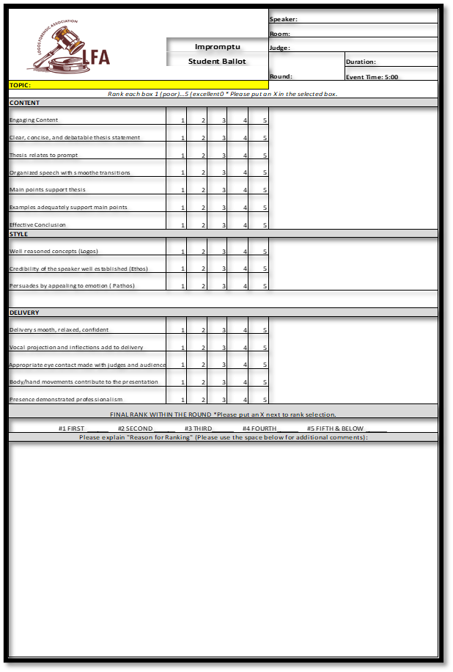
Ballots…
Two Types:
Tabulation Ballot:
Ranking the room
(Event rules will be in your judge packet.)
Student Ballots:
Educate student
Notes:
Ø Judges will be given two types of ballots.
Ø Please check all names on your Tabulation ballot for possible conflicts.
Ø At each tournament, you may judge a speech event only once unless otherwise instructed by tournament leadership. You may judge a competitor in multiple events.
Ø Each of the two ballots has a different purpose.
Ø The Student Ballot is to evaluate and to educate each individual. The speaker receives this ballot at the end of the tournament.
Ø The Tabulation Ballot simply shows how you ranked the speakers in the room from first to last. The speakers do not see this ballot.

Slide 13
Student Ballot…
Please make sure all boxes are filled in. You may mark an X on the point value you wish to assign for each category.
Copy speaker, room, and round from the Master Tabulation Ballot
(Please use dark ink)
Judge = you!
Jot down topic
No minimum time limits
Duration = length of speech
Notes:
Ø When filling out the Student Ballot, please use black or blue ink.
Ø Copy the speaker name, room number, and tournament round from the Tabulation Ballot. And, of course, fill in your own name as the Judge.
Ø There is a line here to jot down the topic.
Ø Duration is the length of speech. This time will be shared from the official timepiece at the end of each presentation.
Ø Each event will note the maximum time limit, and there are no minimum time limits.

Slide 14
Student Ballot Continued…
Using rules
and ballot criteria:
Rate the student’s performance on “Evaluate” scale.
The numbers are not used by the tournament to determine points or rank.
Notes:
Ø Once you have seen a presentation, please rate the student’s performance on each ballot based on each criterion in the "Evaluate scale" column.
Ø This is a basic scale indicating how the competitor measured up to your expectations. The numbers are not used by the tournament to determine points or rank.
Ø Please note any penalties in this section and see staff at Ballot Return for help with penalties.

Slide 15
Student Ballot Continued…
In comments section:
Report what you saw
Educate student:
  What worked
  What didn’t
Reminder: Only 2 minutes between speakers
Notes:
Use the "Comments section"
to report what you saw in each presentation.
This is where you can educate the student on
what worked and
what didn’t work well for you.
To give time for notes, judges may set 2 minutes between speakers for platforms and interpretive events. Limited preparation events must use next students prep time for comments. In Extemporaneous Speaking, the competitors have assigned speaking times and a pre-established order from which they may not deviate. Judges may use any available time between speakers to fill out ballots. Jot down initial feedback. You have plenty of time in the judge’s room later to finish your ballot comments and evaluation.

Slide 16
Ranking
George Washington
Benjamin Franklin
Set ranking
Lady Liberty
*Stacking ballots to order speakers
*For virtual tournaments you can take notes or use blank sheets with student’s names and topics to keep your order and then finalize on the master ballot.
Notes:
The ranking can often be a challenge for judges. It can be so hard to decide first place when everyone seems so good!
Ø To make this job relatively easy, we suggest stacking ballots to order speakers.
Ø Please stack assuming there are no penalties, even if there are penalties.
Ø Here is how it is done: Mark Twain is going to come into your room, and he gives a stellar presentation! He's got to be first! Actually, he really is, since he is the only competitor you have seen. So Mark's ballot gets placed first in your stack.
Ø The second speaker is Ben Franklin. Wow, he's excellent, too! But he's not quite as exceptional as Mark, so he slides into second place. I'm sure you see where this is going.
Ø Third, Marie Curie comes into the room. She's also not quite as compelling as Mark, but she did communicate a little better than Ben, so she slides into second place, moving Ben down to third position.
This method is helpful in establishing your speaker rankings. Just be sure not to drop your papers!!

Slide 17
Tab Ballot…
Review criteria for ranking.
Order speakers from
1st to last
Lady Liberty
Freedom
4:55
Lady Liberty
1
Freedom
Ideas
4:40
Benjamin Franklin
2
Benjamin Franklin
George Washington
Leadership
George Washington
4:19
3
Brian Eschen
4:26
Name that tune
4
NOTE:
There can be no ties
Brian Eschen
Diana Higginson
Diana Higginson
6
Serving
3:10
Steven Butner
Marketing
Steven Butner
4:00
5
Notes:
Review all of the criteria, making sure you are satisfied with how you have stacked your ballots. Now you are ready to complete your Tabulation Ballot.
Ø Remember, there can be no ties.
.

Slide 18
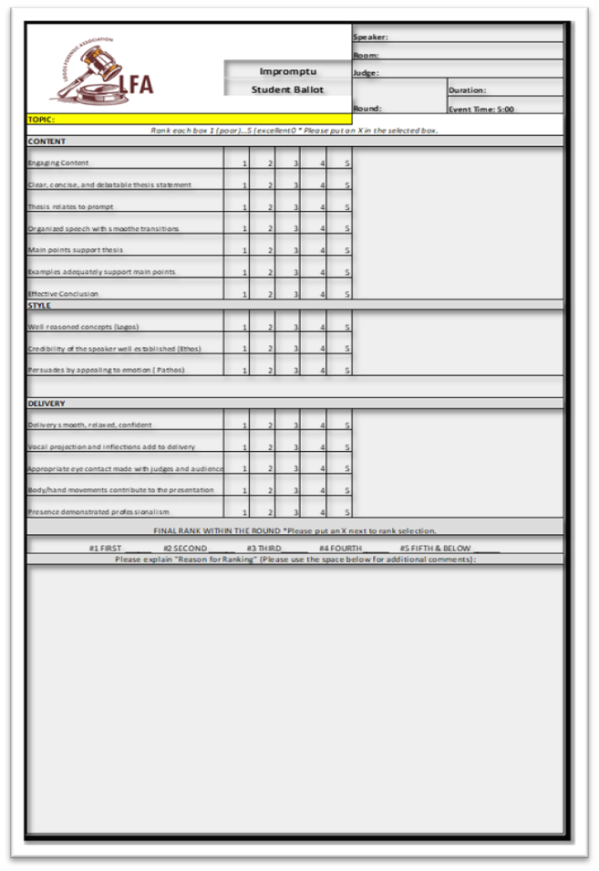
Educate…
Complete comments-
Something done well
Something needing improvement
Circle individual rank
For ranks 5-8
Circle 5th and Below
Reason for ranking -
Compared to others in round
Notes:
Now that you have completed the ranking of the room, it is time to further educate the individual speakers.
Ø Complete any comments on your student ballots. Just share your observations.
Ø Tell them at least one thing they did well and one thing needing improvement.
Please don't underestimate the impact this will have on each competitor. They really do crave constructive criticism to improve their skills.
Ø At the bottom of the Student Ballot, circle the individual rank for each student.
Ø While the Tabulation Ballot must have unique numbers for first through eighth place, each Student Ballot will be marked first through fourth, and for students ranking fifth through last place, you will circle the complete phrase, "5th and Below".
Ø Finally, give the students a reason for their ranking compared to others in the round. The students are looking for what they could do to move up a rank in your evaluation. Your comments truly are valuable to them.

Slide 19
After you hear all the speakers…
Return immediately to the Judge Hospitality (virtual judge room) area to complete your ballots.
If you have questions, please see one of the Judge Orientation staff who will be available in the ballot return area or via the judge room/chat box. If sending a message, please make sure the message is a direct message with the host. Other wise chats will be visible in the chat box.
Once your ballots are complete, check in with Ballot Return and wait as they review through them.
Notes:
Ø After you have heard all the speakers,
Ø Please return immediately to the Judge Hospitality area to complete your ballots.
Ø If you have questions, see one of the judge orientation staff who will be located close to the Ballot Return area.
Ø Once your ballots are complete, check in with Ballot Return staff and wait as they review them.

Slide 20
A few final reminders…
Read the rules that were provided before judging
Have fun and know that you are serving in a vital education role for each student!
Thank you!
Notes:
Here are a few final reminders to help you feel prepared:
Read the rules on the back of your tabulation ballot before you begin judging.
The numbers 1-5 are never added up or used by the tournament staff. They are for your evaluation purposes only.
The Head Judge will manage the timepiece in your room. All judges record the official time. A penalty must be applied if the competitor goes 15 seconds or more overtime.
All required penalties should be confirmed with the other judges before leaving the room.
Please do not confer with the other judges or ask questions of anyone besides the assigned staff. Orientation staff will be available to assist you and answer any questions when you return to the judge hospitality area.
Have fun and know that you are serving in a vital education role for each student! Thank you for serving!

Slide 21
LFA Statement of Faith
We believe...
...that the Holy Scriptures, comprised of the 66 books of the Old and New Testaments, are fully inspired by God and are therefore infallible in the original writings and completely trustworthy in all areas in which they speak.
...that there is only one eternal, almighty and perfect God. Within the Being of this one true God exist three eternally distinct and coequal Persons: the Father, the Son, and the Holy Spirit. These three Persons, also referred to as the Trinity, are the one true God.
...that Jesus Christ is the eternal Son of God, the Second Person of the Trinity, who took upon Himself human flesh through the miraculous conception by the Holy Spirit in the womb of the virgin Mary. He who is true God became true man, uniting two natures in one person forever. Christ lived a perfect, sinless life, died on the cross as an atoning sacrifice for our sins, rose bodily from the dead, and ascended into Heaven where He now serves as our High Priest, our only Mediator.
...that the Holy Spirit is the eternal Third Person of the Triune God, the Regenerator and Sanctifier of the redeemed, the Bestower of spiritual fruit and gifts, and the abiding Advocate who empowers believers for godly living and service.
...that Adam was directly created without sin and in the image of God and did not evolve from preexisting forms of life. Through the fall of Adam that image of God in humanity has been defiled, although not eradicated. Every human being is radically corrupt and estranged from God. Human beings are condemned by God because of their descent into sin through their relationship to Adam. The desperate need of humanity is forgiveness of sins and consequent restoration of fellowship with God; yet humans remain totally unable to atone for and restore themselves.
...that Jesus' death on the cross provided a substitutiary atonement for the sins of humanity. We believe that man is justified (saved) by grace through faith in the shed blood of the Lord Jesus Christ without any mixture of works. ...in the existence of Satan and that hell is a place of eternal conscious punishment for him, his host, and all unbelievers.
...that the Christian church is composed of all persons who through saving faith in Jesus Christ have been regenerated by the Holy Spirit. Corporately and individually, its members strive to worship, serve, and glorify God through prayer and praise, diligent study and application of the Scriptures, evangelism, sanctified living, good works, and observance of the rites of baptism and the Lord's Supper. The mission of the church is the discipleship of all nations - not only the saving of souls but also the bringing of the gospel to bear on every aspect of life and thought.
Notes:
Thank you for reading the LFA Statement of Faith before considering an Apologetics ballot. Remember, if you agree with these statements please feel free to request an Apologetics ballot. If not, consider judging one of our other speech events.

