Slide 1
Team Policy Debate Orientation

Slide 2
Volunteers make it happen!
We can’t do this without you.
You are making an investment.
You are performing a teaching role in the lives of our students.
You make it possible for young people to learn these skills.
Thank You!

Slide 3
You are Qualified to Judge!
You already participate in communication activities.
It is the speaker’s job to communicate with you.
It is not your job to be a debate expert.
Our goal is for our students to speak to “the thinking man and woman on the street”.
That’s You!

Slide 4
What to Expect
There is one judge in preliminary rounds. That number increases in elimination rounds.
If there is a timekeeper, they will give verbal signals during prep time and hand signals during speaking times.
Debaters may also self-time.
Debaters will introduce themselves and may ask your judging philosophy.

Slide 5
What is Debate?
Two opposing teams argue an idea: the Resolution.
Affirmative upholds the resolution.
First Affirmative
Second Affirmative
Negative refutes Affirmative position.
First Negative
Second Negative
Debaters alternate sides during the tournament.

Slide 6
2022-23 Debate Resolution
Resolved:
The United States federal government should substantially reform its agricultural and/or food policy in the United States.

Slide 7
Round Structure
8 min. First Affirmative Constructive
3 min. Cross Examination
8 min. First Negative Constructive
3 min. Cross Examination
8 min. Second Affirmative Constructive
3 min. Cross Examination
8 min. Second Negative Constructive
3 min. Cross Examination
5 min. First Negative Rebuttal
5 min. First Affirmative Rebuttal
5 min. Second Negative Rebuttal
5 min. Second Affirmative Rebuttal

Slide 8
Constructives
Each debater has one constructive speech.
The first affirmative constructive (1AC) is typically pre-written and presents a case to uphold the resolution.
All constructive speeches may be used to introduce, build, and respond to arguments.

Slide 9
Cross-Examination
One-on-one question and answer.
Only direct interaction in the round between the debaters.
Debaters face the judge.
Judges may not question/comment during this time or at all during the round.

Slide 10
Rebuttals
Rebuttal speeches are used to respond to and extend existing lines of argumentation.
No new lines of argumentation may be presented in rebuttal speeches.
Rebuttal speeches may include new evidence, examples, analysis, and analogies offered to support previously introduced lines of argumentation.
If a team introduces a new line of argumentation into the round during the rebuttals, the judge should disregard these arguments when evaluating the round.

Slide 11
Support
Team Policy makes use of a wide variety of support to defend and clarify arguments, which may include (but is not limited to):
The debaters may persuade you as to which types of support are best for the issues at hand.
logic definitions applications analogies | quotations facts evidence (cited materials) | examples historical events

Slide 12
Evidence
Evidence is the oral presentation of quoted text with a citation.
Evidence must be on paper in the debate room.
The written citation must include:
Author (if available)
Publication Name
Date
URL (if available)
The citation should be located directly above or below the text.
Evidence must be read verbatim from the beginning of the sentence until the ending punctuation.

Slide 13
Evidence
At the end of the round, you may request to review written materials for clarification or accuracy.
You may only review materials that were read orally in the round.
Do not ask the debaters for clarification of evidence or arguments.
Make sure to return any evidence you review before leaving the room.

Slide 14
Other Key Considerations
Time Limits
Once the time is expired at the end of a speech, a debater may complete a sentence, but should not start a new thought.
Once time has expired, judges are free to discard additional comments or speech content when evaluating the round.
Debater Communication
Debaters may communicate and pass notes discreetly at the table.
Debater Prep time
Each team has a total of 5 minutes for preparation between speeches. The timekeeper should state start and end of this prep time, and any time remaining.

Slide 15
Debater’s Role
The debaters are responsible for making their ideas clear to the judge, including:
Debate theory.
Organization of the ideas and arguments in the round.
Details of the topic.

Slide 16
Role of the Judge
Things to Do:
Do set aside your personal bias.
Do decide which debater best supports his or her position.
Do provide written feedback.

Slide 17
Role of the Judge
Things not to Do:
Don’t interrupt or question the debaters.
Don’t leave the room or take phone calls during the round.
Don’t discuss the round with the debaters, audience or other judges when it is finished.

Slide 18
Flowing/Note-taking
Organizes the ideas in a round
Use flow sheet or plain paper.
Just a tool to help you.
Not to be turned in.
The right note-taking system allows you to:
Absorb the presentation.
Reach a conclusion and cast a vote.
Give the debaters written feedback.

Slide 19
Flowsheet
Notes:
There is not a column provided on the flowsheet for cross examination, however, you may use the back for notes. It is blank. You do not need to turn in your flow sheet or any notes. They are yours to keep & we do not need to see them.

Slide 20
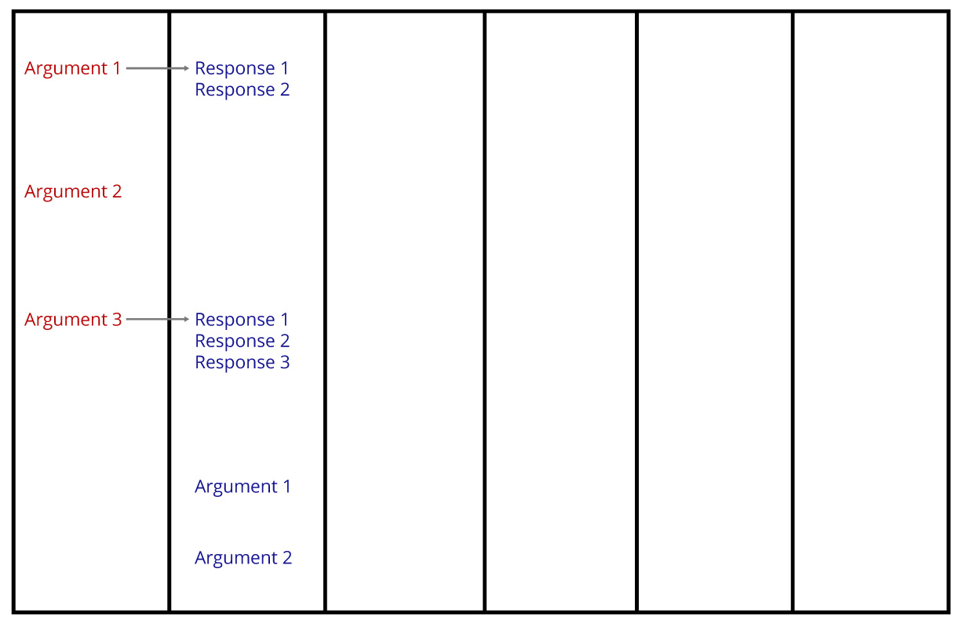
Flowsheet
Notes:
There is not a column provided on the flowsheet for cross examination, however, you may use the back for notes. It is blank. You do not need to turn in your flow sheet or any notes. They are yours to keep & we do not need to see them.

Slide 21
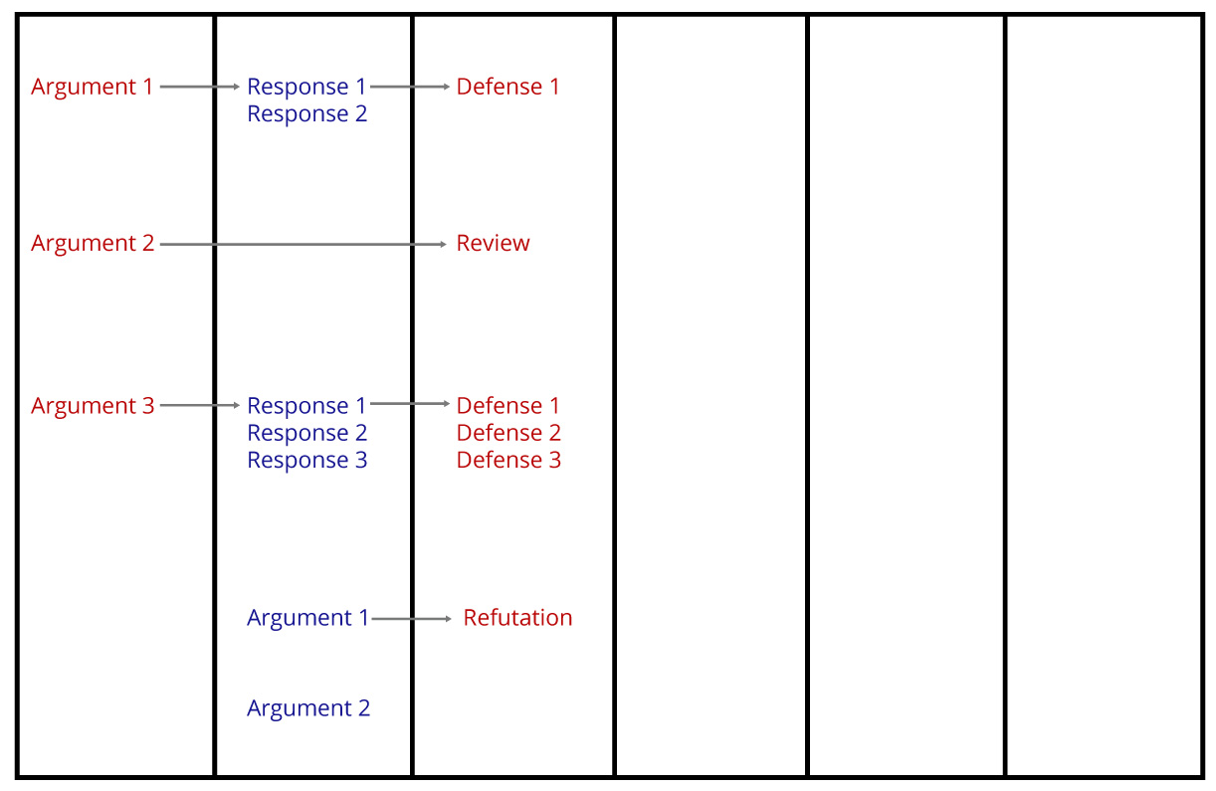
Flowsheet
Notes:
There is not a column provided on the flowsheet for cross examination, however, you may use the back for notes. It is blank. You do not need to turn in your flow sheet or any notes. They are yours to keep & we do not need to see them.

Slide 22
Before the Round Begins
Check to make sure:
You have not judged either of these teams in this event at this tournament.
Find the room number.
Make sure the tournament knows which ballot you have.
Fill in your name (if needed).

Slide 23
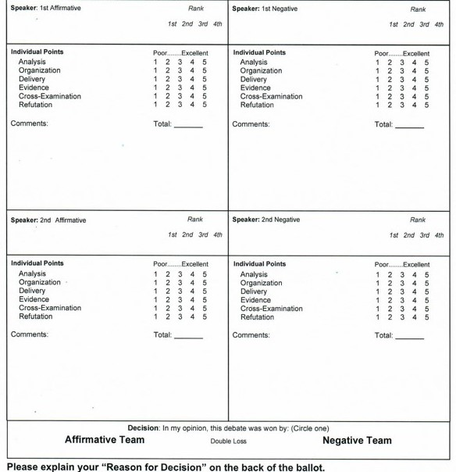
Before the Round Begins
The ballot has space for the four names of the debaters:
If these are already filled in, verify the speaker positions.
If these are not filled in, write them in before the round starts! (Debaters will be happy to help.)
Now, the debate may begin and you are ready to listen and take notes.

Slide 24
Filling Out the Ballot
Two Independent Decisions:
Decide which team wins the round. Arguments are more important than presentation.
Reward individual presentation.
Set aside personal bias/opinion.

Slide 25
Evaluating the Round
The Affirmative team has the “burden of proof”. Did the Affirmative team...
Stay on topic? (topicality)
Provide a significant reason for change? (significance)
Propose a solution that doesn’t currently exist? (inherency)
Present a plan that will work? (solvency)
Show that the advantages outweigh the disadvantages?
The Negative team may persuade you that the Affirmative team does not fulfill one or more of the above burdens.

Slide 26
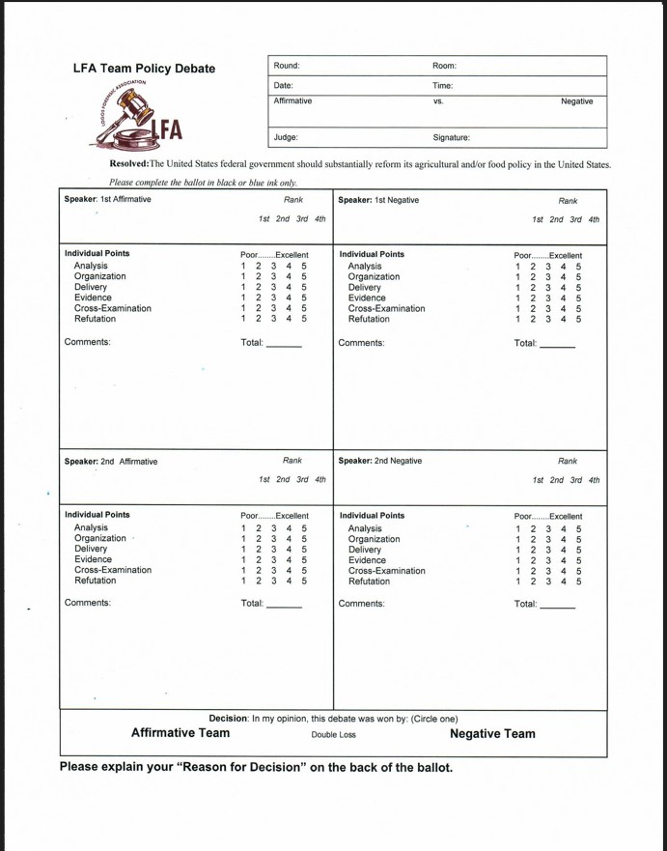
The Student Ballot
Vote Affirmative or Negative
Double Loss is disciplinary.
Lower points may win the round.
Evaluate the Debaters
Write comments.
Circle and total the points.
Rank debaters.
Notes:
NOTE to presenters: only orient the ballot(s) that YOUR TOURNAMENT IS USING

Slide 27
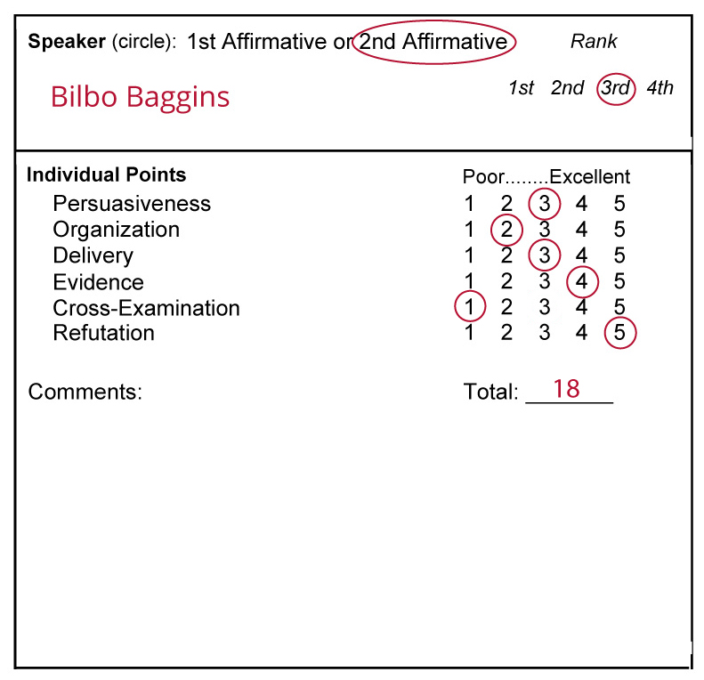
Individual Points/Rank
Total Points
1 = poor…5 = excellent.
Points may be tied, ties are broken with rank.
Lower points may win the round.
Rank
Rank debaters sequentially by points (most points = 1st, least points = 4th).

Slide 28
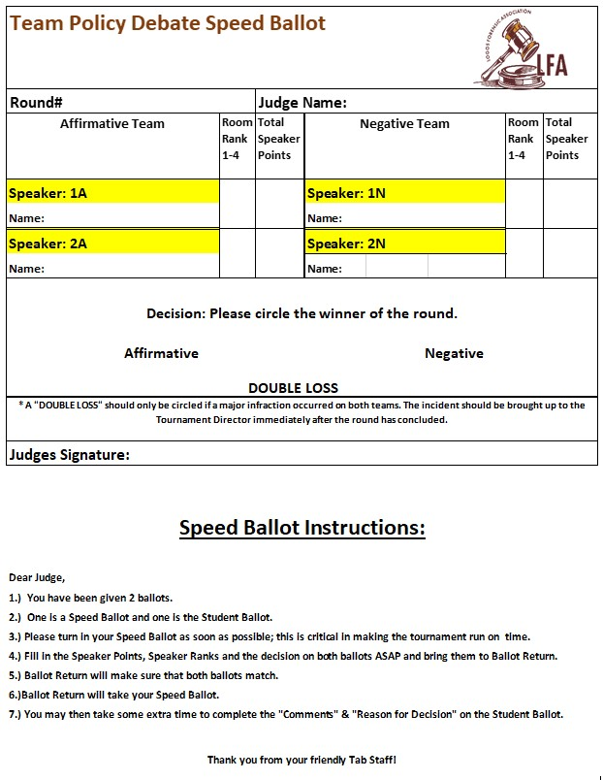
The Speed Ballot
Only pertinent information needed for tabulation.
Vote Affirmative or Negative.
Provide individual points.
Rank debaters.
Turn in as soon as possible.
Notes:
NOTE to presenters: only orient the ballot(s) that YOUR TOURNAMENT IS USING

Slide 29
Ballot: Reason For Decision
Judge round based upon issues discussed in the round.
Set aside your personal bias/opinion.
Be prepared to vote for a position you do not personally hold.
Notes:
The purposes of the ballot: To encourage the students, whenever possible tell the losing team what they could have done to earn your ballot.

Slide 30
Ballot: Reason For Decision
The most important thing you can do to help the students is explain your reason for decision (why did you vote the way you did?).
Students read your ballot to learn where they can improve for next time.
You can use the back of the ballot for extra space to write your thoughts.
Notes:
The purposes of the ballot: To encourage the students, whenever possible tell the losing team what they could have done to earn your ballot.

Slide 31
When the Round is Over
Do not disclose your decision.
Do not ask questions or give verbal feedback.
Do not solicit opinions about the round from other observers in the room.
Immediately following the round, take your ballots to the designated area for completion.
Notes:
Put positive before negative

Slide 32
Rules
Judge Orientation Staff Available
If you have questions concerning the round or your ballot, staff is available to answer your questions in the judge’s area.
Written Rules Available
Written rules are available in the judge’s area.

Slide 33
Thank You!

